Slide 1
Modern Mobile App Development
Michael Watson
Global Black Belt Modern App TSP (aka: the Xamarin guy)

Slide 2





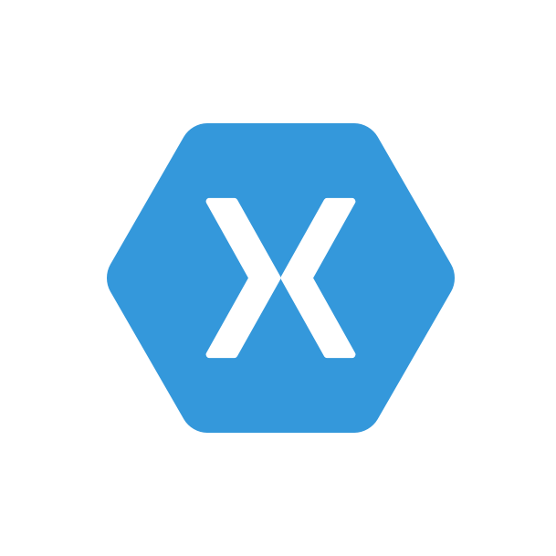

Mobile DevOps Components
Code Repository
Build + Deploy
App Testing
Beta Testing
Backlog
Telemetry Collection
Monitor and improve

Slide 3
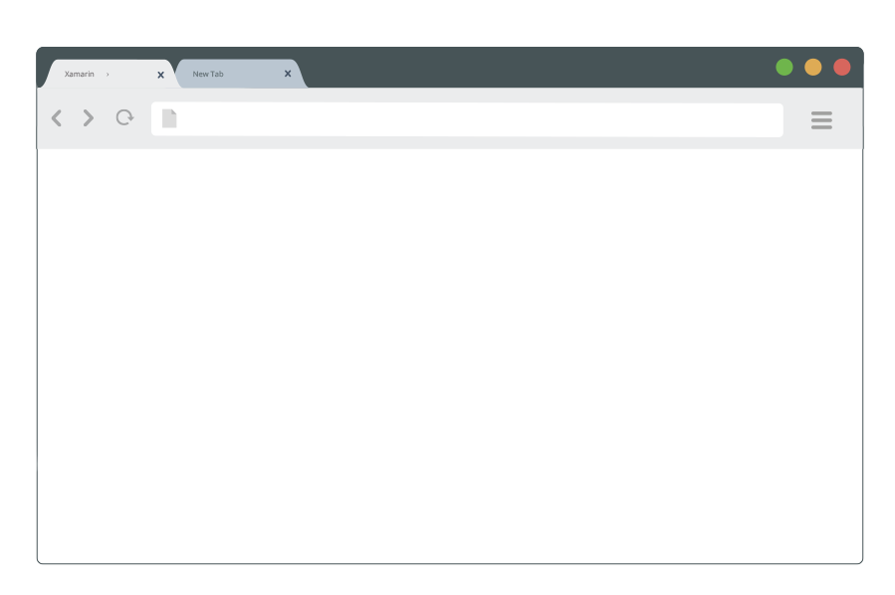
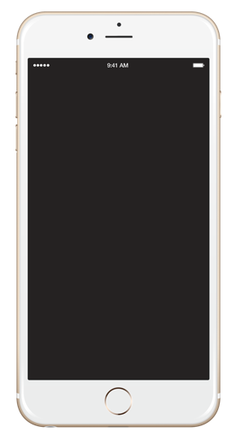
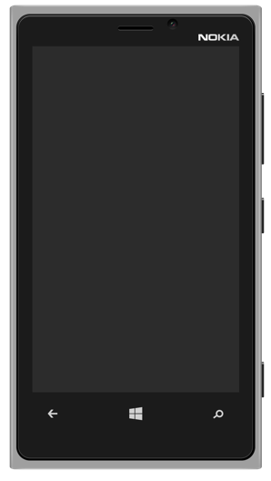
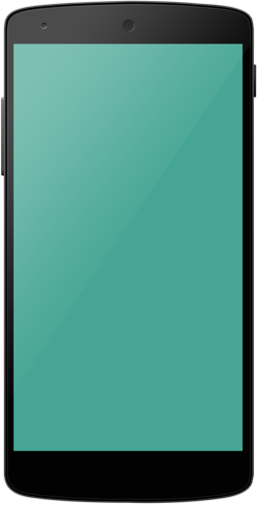



Three mobile approaches
1. Hybrid / Web
2. Platform-Specific
3. Cross-Platform Native
HTML 5
Proprietary languages
Obj C
C#
Java
Shared Code
User experience
Limited functionality, slow performance | Native experience, high performance | Fully native UI and performance; high fidelity API access
Build once, scale quickly | Long development and maintenance time for 3 code bases | Only one code base, one team to maintain
Reliance on third party vendors for full lifecycle support | Little to no development support from platforms | Full support throughout the development lifecycle
App factory for scale
Ecosystem integration
Notes:
SCRIPT:
In the past, companies started to do build mobile apps by using web technology and fitting a web page onto a mobile phone. The upside of this approach was the ability to use skills that most companies had in house and one app could reach all users so it was pretty low cost. The downside to this was a poor user experience and some serious functional shortcomings - no offline data sync, and no access to native device functions.
Then Apple launched the iPhone and delivered exactly the kind of native experience everyone wanted. But when Android and later Microsoft followed suit with similar technologies on different OSs, all of a sudden you’re building the same app two or three times, which is expensive and redundant, and it slows down organizations’ ability to innovate, update, and fix apps.
The cross-platform native approach is the best of both worlds. You get the native user experiences as though written for each individual platform, and you also eliminate rework and accelerates organizational innovation and responsiveness.

Slide 4

Truly native cross-platform solution
Native user interface
High-fidelity API access
Native performance
Anything you can do in Objective-C, Swift or Java, you can do with Xamarin
Notes:
Apps are built with standard, native user interface controls for easy and familiar interactions
Apps have access to the full spectrum of functionality exposed by the underlying platform and device.
Apps leverage platform-specific hardware acceleration, and are compiled as native binaries, not interpreted at runtime

Slide 5
Xamarin’s Unique Approach
iOS C# UI
Android C# UI
Windows C# UI
Azure
Linux/Mono
CoreCLR
Shared C# Mobile
C# Server
Shared C# Client/Server
Shared C# codebase • 100% native API access • High performance
Notes:
Talking Points:
With Xamarin, you write your apps *entirely* in C#, sharing *all* of your application logic, data models and backend integration across platforms.
There are two ways to architect Xamarin apps – sharing between 60-90%+ code across all platforms. You can start from platform-specific, pick a few screens, or start with forms, and replace with platform-specific later.
Xamarin.iOS/Xamarin.Android: you are also able to build a beautiful user-interface, leveraging the native APIs for iOS, Android, and Windows, which allows you to render the nuances on every device and access all device-specific functionality.
This enables developers to be highly productive, share code, but build out UI on each platform and access platform APIs
With Xamarin.Forms, you can share UI code as well, and still deliver a fully native experience. Xamarin.Forms makes it possible to share nearly 100% of source code across platforms.
With Xamarin.Forms you now have a nice Shared UI Code layer, but still access to platform APIs

Slide 6
Xamarin + Xamarin.Forms
iOS C# UI
Android C# UI
Windows C# UI
Shared UI Code
Shared C# Backend
Shared C# Backend
Xamarin.iOS/Xamarin.Android
With Xamarin.Forms: More code-sharing, all native
Notes:
Talking Points:
With Xamarin, you write your apps *entirely* in C#, sharing *all* of your application logic, data models and backend integration across platforms.
There are two ways to architect Xamarin apps – sharing between 60-90%+ code across all platforms. You can start from platform-specific, pick a few screens, or start with forms, and replace with platform-specific later.
Xamarin.iOS/Xamarin.Android: you are also able to build a beautiful user-interface, leveraging the native APIs for iOS, Android, and Windows, which allows you to render the nuances on every device and access all device-specific functionality.
This enables developers to be highly productive, share code, but build out UI on each platform and access platform APIs
With Xamarin.Forms, you can share UI code as well, and still deliver a fully native experience. Xamarin.Forms makes it possible to share nearly 100% of source code across platforms.
With Xamarin.Forms you now have a nice Shared UI Code layer, but still access to platform APIs

Slide 7
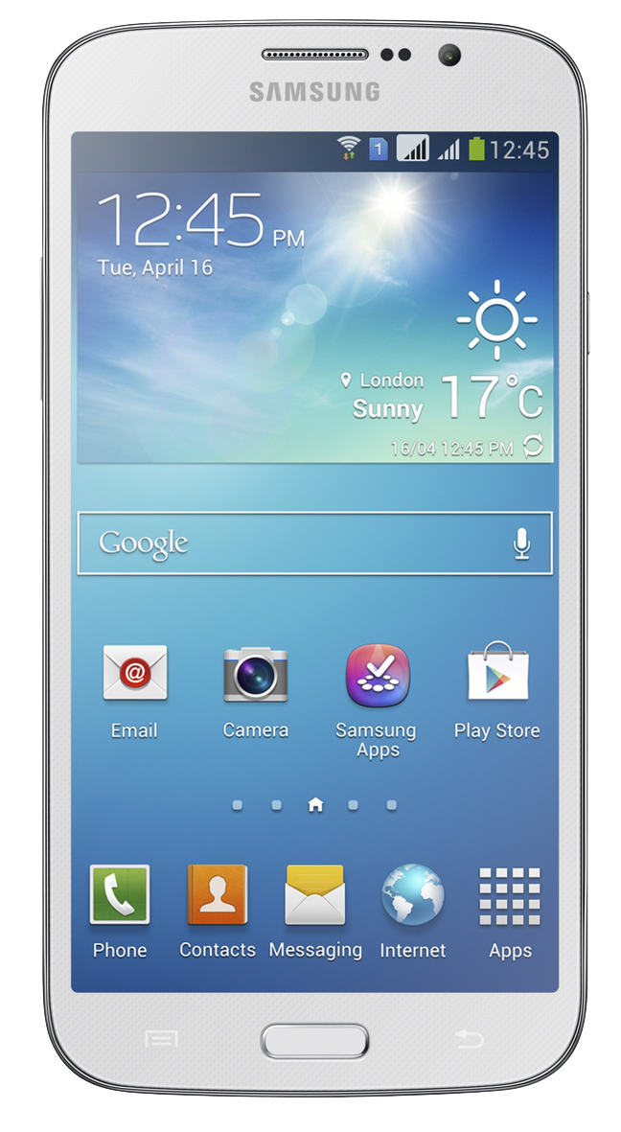
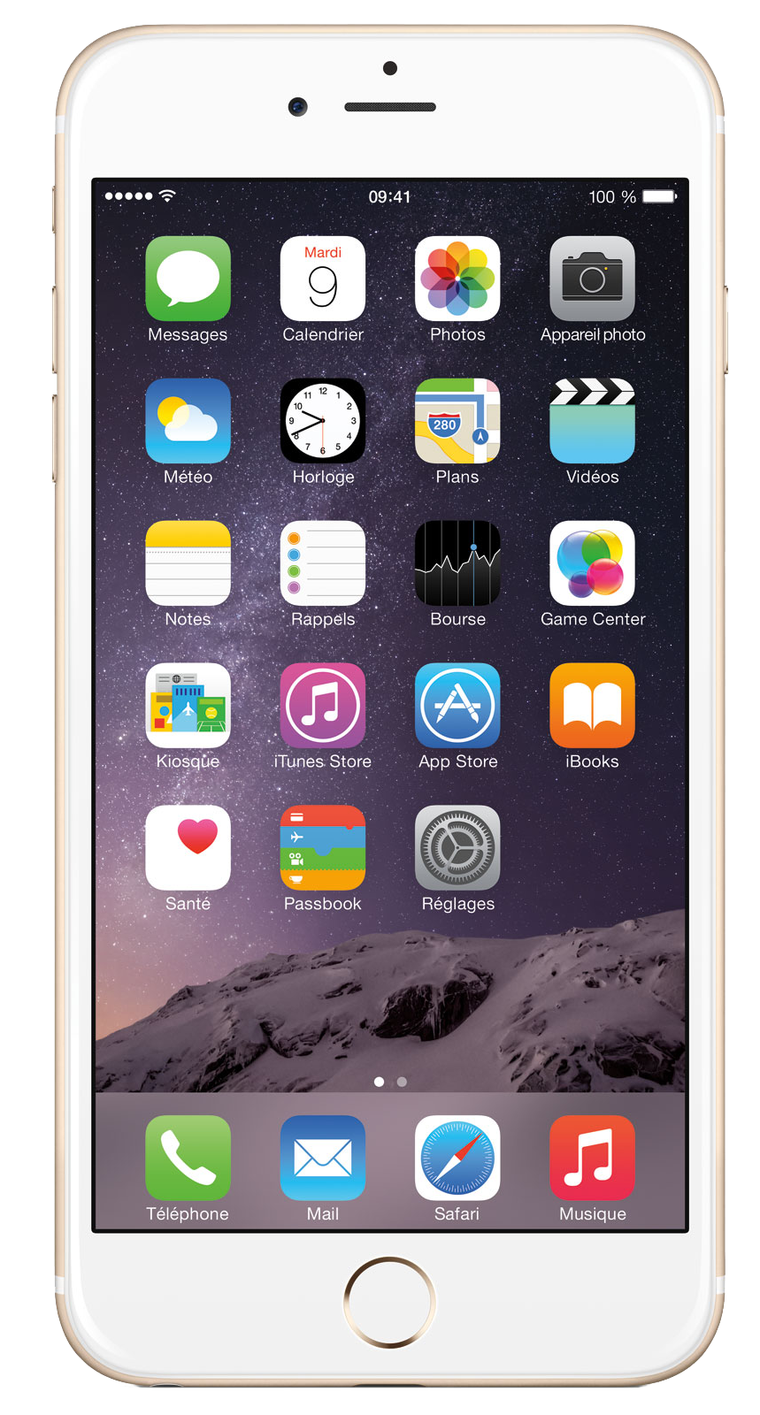
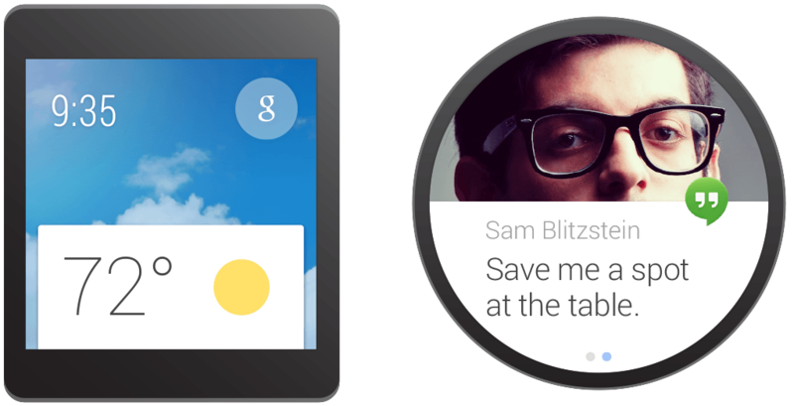
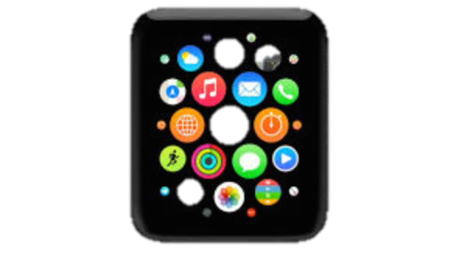
Completely up-to-date with device OS releases
Always up-to-date with Apple and Google API releases.
Track record of offering same-day support: iOS 5, 6, 7, 8, 9, 10
The only cross-platform solution with support for the Google Glass SDK, Android Wear, Amazon Fire TV, Apple Watch, Apple TV, and Tizen*.
* Tizen support provided by Samsung via Xamarin.Forms

Slide 8
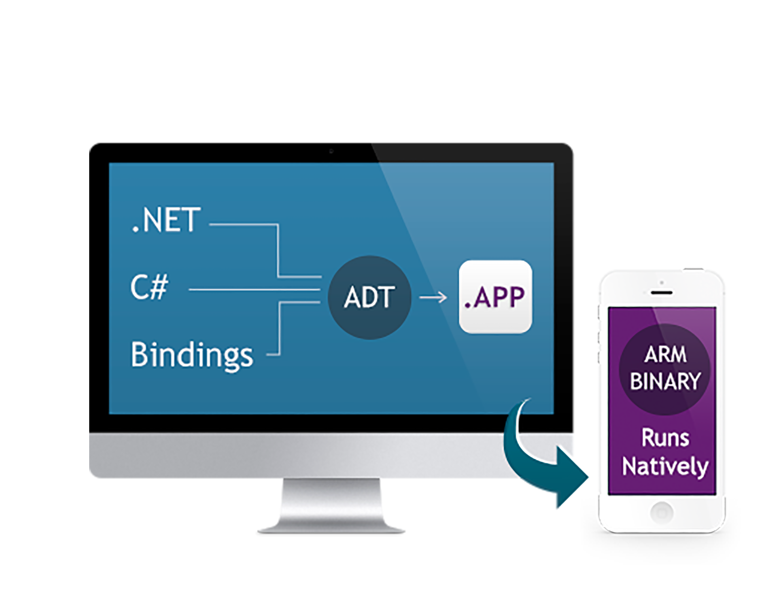
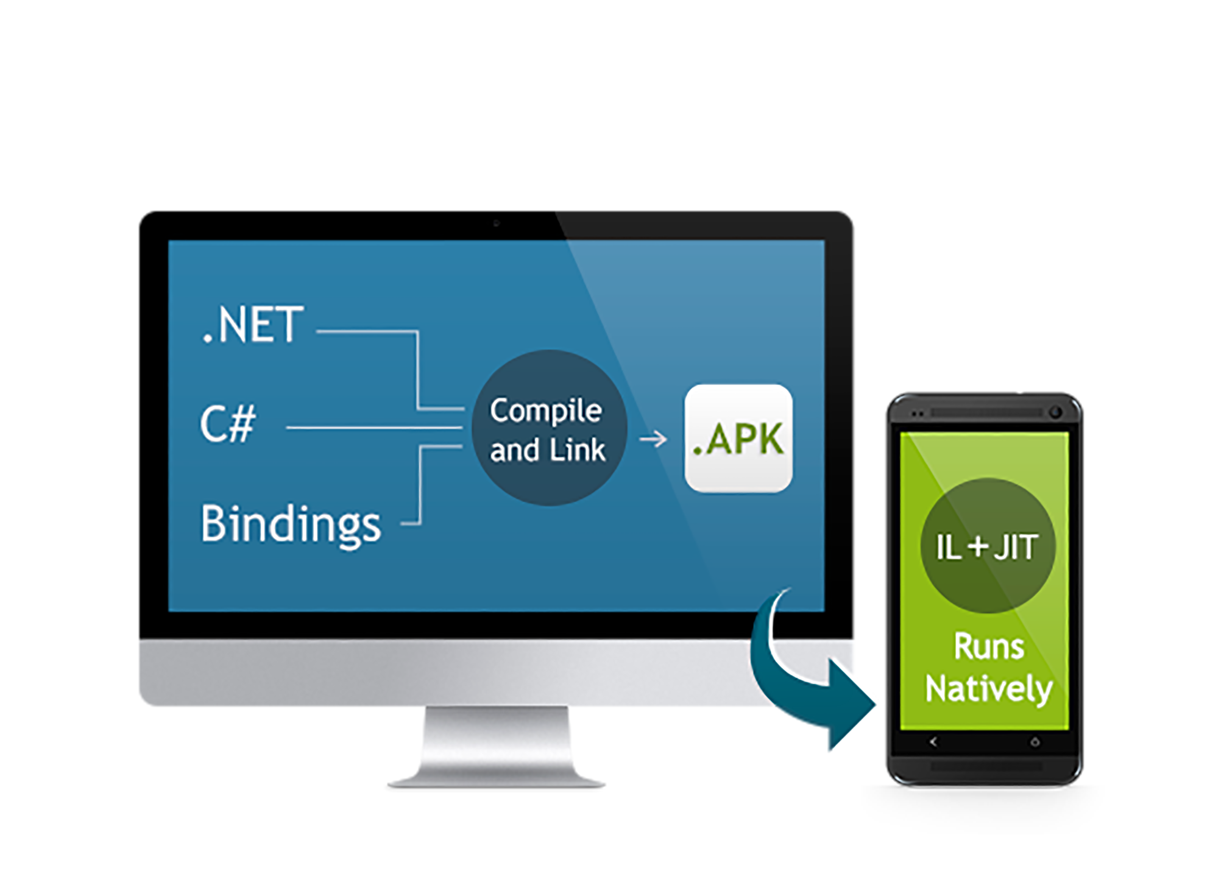
Native Performance
Xamarin.iOS does full Ahead Of Time (AOT) compilation to produce an ARM binary for Apple’s App Store.
Xamarin.Android takes advantage of Just In Time (JIT) compilation on the Android device.

Slide 9
Architecture of a Modern Mobile App

Slide 10
Mobile DevOps Components
Code Repository
Build + Deploy
App Testing
Beta Testing
Backlog
Telemetry Collection
Monitor and improve

Slide 11
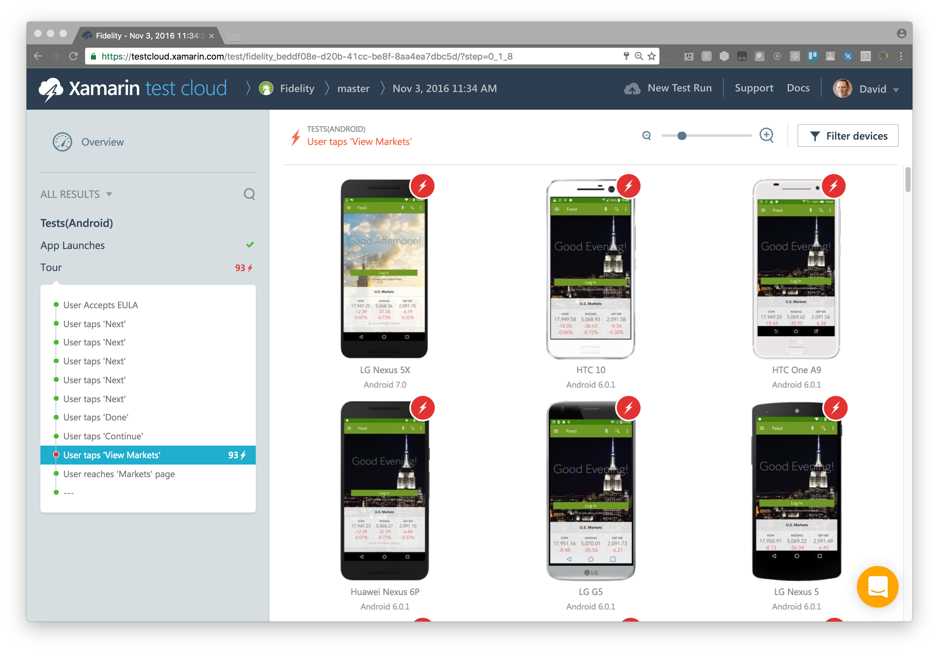
Xamarin Test Cloud
Automated app testing on thousands of real devices
Support for industry standard automation frameworks
Screenshots and video recording of apps
Integrate with any CI system

Slide 12
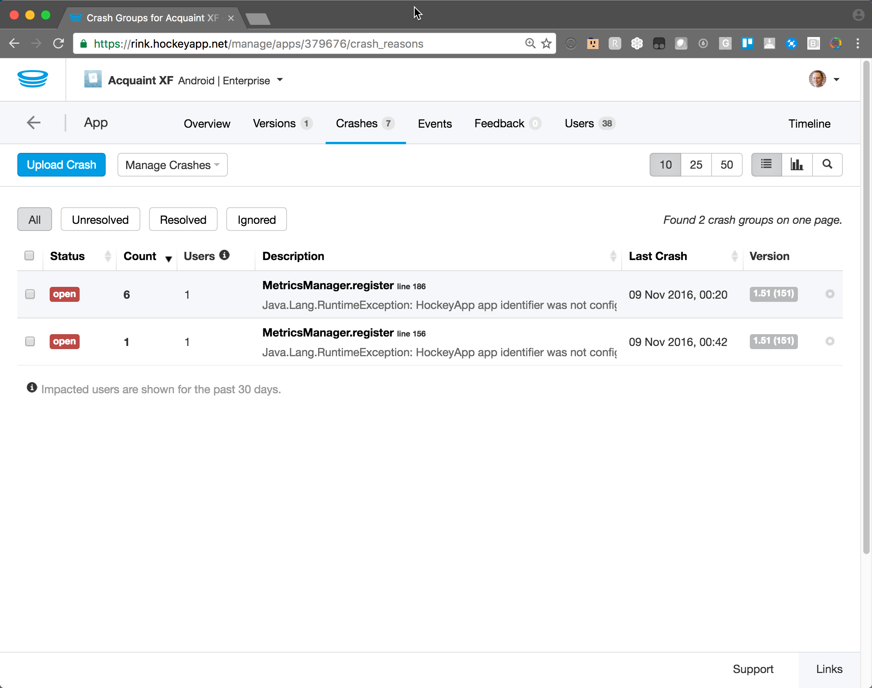
HockeyApp
Crash Reporting
Analytics
Beta Distribution

Slide 13
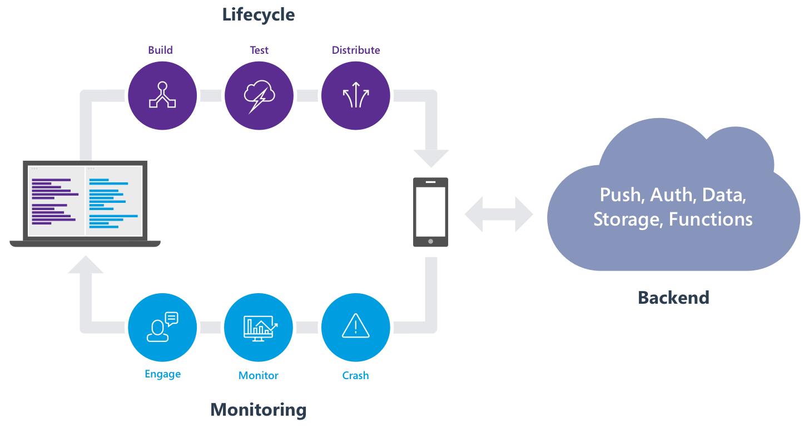
What is Visual Studio Mobile Center?

Slide 14
Mobile Center’s Services
Building
Powering
Learning
_
Notes:
We’ve taken the technology from our various services and are combining them with Azure App Service to create something truly unique. With Sonoma, mobile developers will be able to go to one place and do everything they need: from CI to releasing beta builds to powering their apps back-end to learning how their app is truly performing out their in the wild.
This is something no other company can do as well as us. Microsoft loves developers and we truly understand them like no other company. We have no agenda except to build the greatest developer tools in the world.

